Slide 1

Modern DNA sequencing, FASTQ format, tools.
Applied Computational Genomics, Lecture 06
https://github.com/quinlan-lab/applied-computational-genomics
Aaron Quinlan
Departments of Human Genetics and Biomedical Informatics
USTAR Center for Genetic Discovery
University of Utah
quinlanlab.org

Slide 2
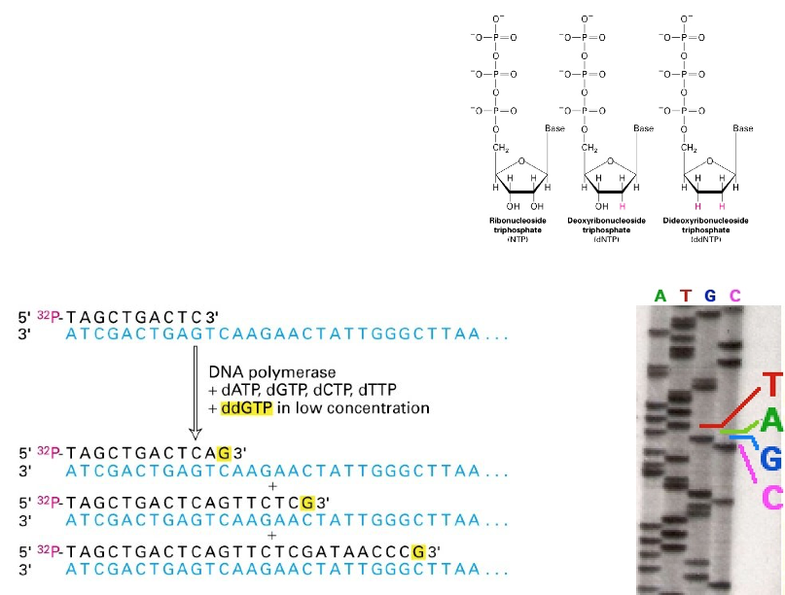
How to sequence a human genome: Sanger method
Key points:
1) sequencing by synthesis (not degradation)
2) primers hybridize to DNA
3) polymerase + dNTPS + ddNTP terminators at low concentration
3) 1 lane per base, visually interpret ladder

Slide 3
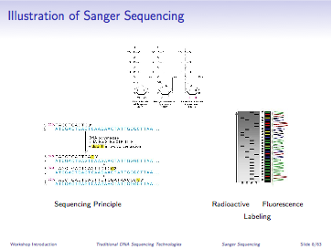
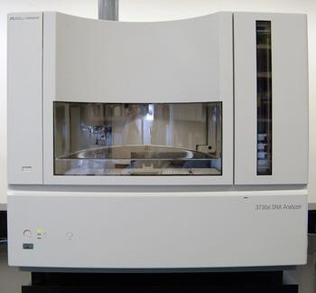
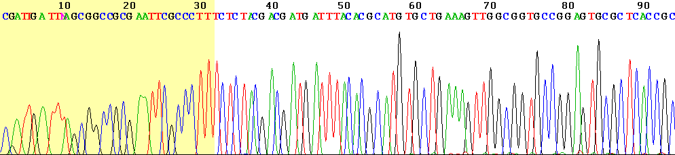
How to sequence a human genome: Lee Hood automation
before
after
read lengths: ~500bp
Slide from Ira Hall

Slide 4
Sanger sequencing: technological advances
1977: Fred Sanger
1 hard working technician
= 700 bases per day
= 118,000 years to sequence the human genome
1985: ABI 370 (first automated sequencer)
5000 bases per day
= 16,000 years
1995: ABI 377 (Bigger gels, better chemistry & optics, more sensitive dyes, faster computers)
19,000 bases per day
= 4,400 years
1999: ABI 3700 (96 capillaries, 96 well plates, fluid handling robots)
400,000 bases per day
= 205 years
Slide from Ira Hall

Slide 5
The next wave of DNA sequencing technologies
2005: 454 (Roche)
2006: Solexa (Illumina)
2007: ABI/SOLiD (Life Technologies)
2010: Complete Genomics
2011: Pacific Biosciences
2010: Ion Torrent (Life Technologies)
2015: Oxford Nanopore Technologies
whiz-bang terms
“Massively parallel” sequencing
“High-throughput” sequencing
“Ultra high-throughput” sequencing
“Next generation” sequencing (NGS)
“Second generation” sequencing
Slide from Ira Hall

Slide 6
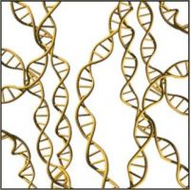
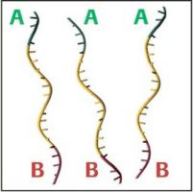
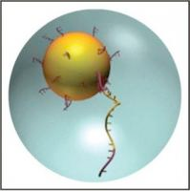
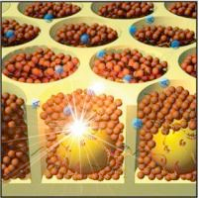
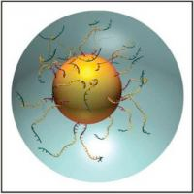
Breakthrough #1: 454 sequencing
1) shear DNA
2) add adaptors
3) attach to beads; trap in oil droplet micro-reactors
5) trap DNA-coated beads in wells
(up to 1 million)
4) amplify w/ PCR
Slide from Ira Hall
Jonathan Rothberg, 2005

Slide 7
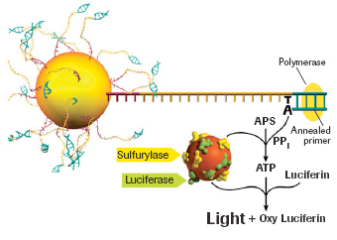
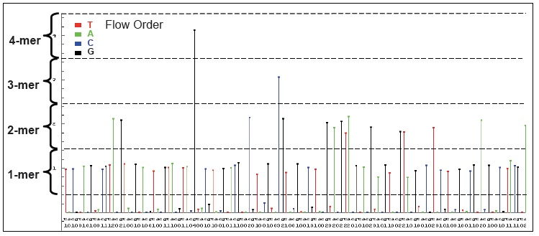
Pyrosequencing: luciferase from fireflies
Protocol:
1) Hybridize sequencing primer
2) add DNA polymerase, ATP sulfurylase, luciferase, apyrase & substrates (adenosine 5´ phosphosulfate (APS) and luciferin)
3) nucleotide incorporation catalyzes chain reaction that results in light
4) Add bases sequentially
- add A, take a picture: did it flash?; wash
- add T: did it flash?wash
- add G: did it flash?wash
- add C: did it flash?wash
Repeat ~500 times
Slide from Ira Hall
Pål Nyrén and Mostafa Ronaghi, 1996

Slide 8
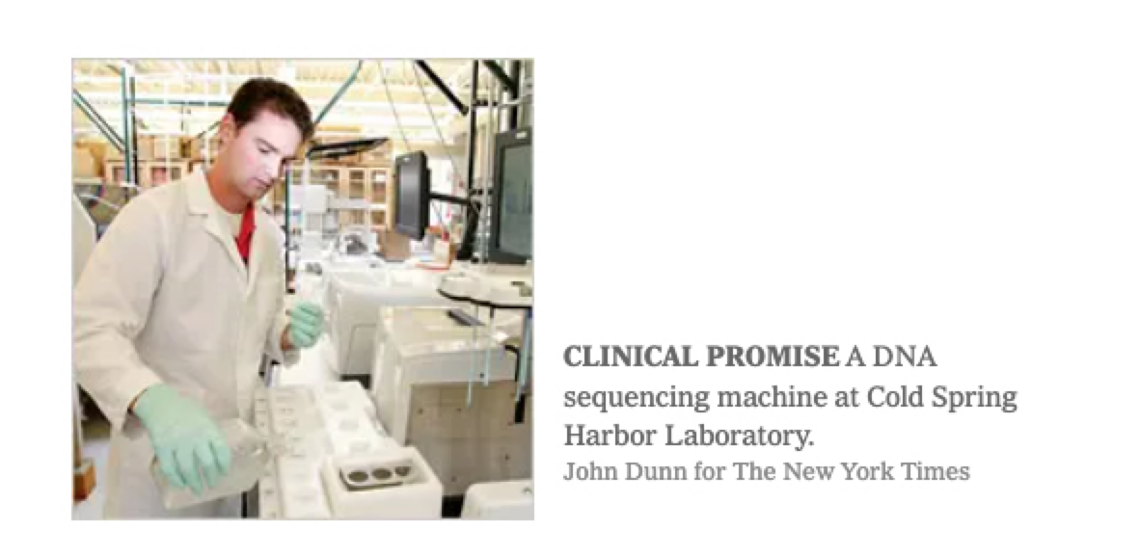
An aside: Humble beginnings
https://www.nytimes.com/2006/07/18/science/18dna.html

Slide 9
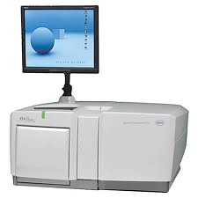
454 sequencing: summary
First post-Sanger technology (2005)
used to sequence many microorganisms & Jim Watson’s genome (for $2M in 2007)
Longer reads than Illumina, but much lower yield (~500bp)
Rapidly outpaced by other technologies - now essentially obsolete
Slide from Ira Hall

Slide 10
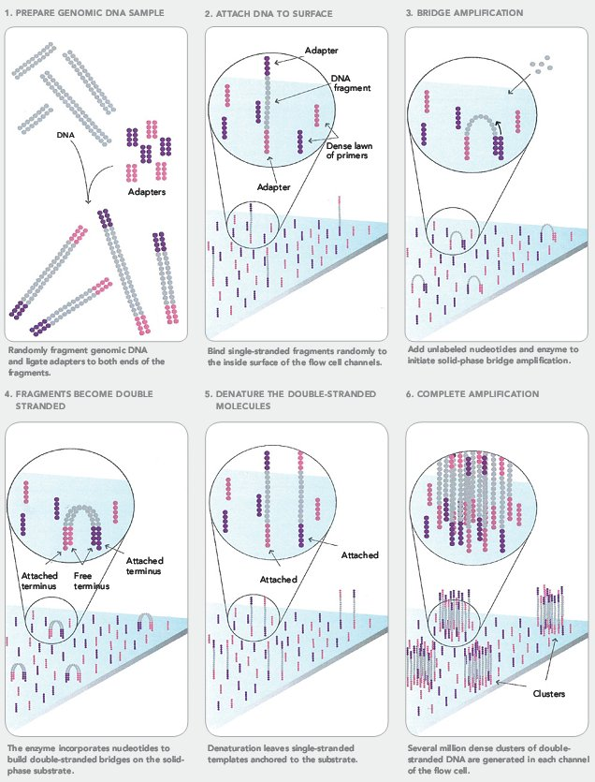
Breakthrough #2: Solexa (Illumina) sequencing (2006)
PCR amplify sample (opt.)
Immobilize and amplify single molecules on a solid surface
Reversible terminator sequencing with 4 color dye-labelled nucleotides
Slide from Ira Hall

Slide 11

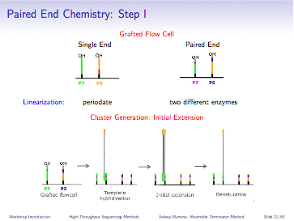
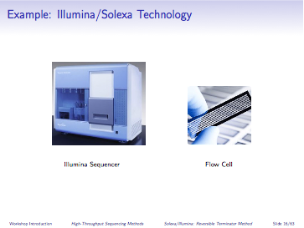
Immobilizing single molecules
1) Prepare Sequencing Library
Fragment DNA
Add adaptors,
size select, PCR
denature
2) Seed Flow Cell with Single Molecules
Load flow cell
Flow cell surface w/ attached primers
Template
Hybridization
Initial Extension
Denaturation
Slide from Ira Hall

Slide 12

Cluster amplification by "bridge" PCR

Slide 13
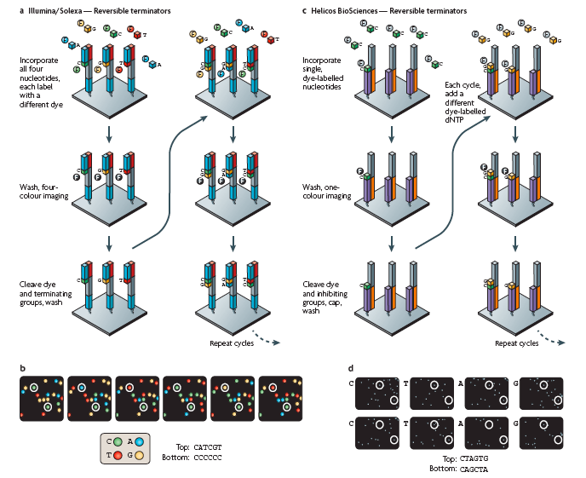

Cluster amplification by "bridge" PCR
4 different images merged
6 cycles w/ base-calling
Slide from Ira Hall

Slide 14
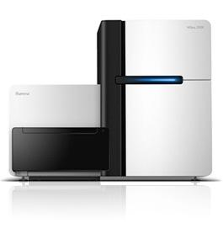
Illumina sequencing summary
Advantages:
Best throughput, accuracy and read length for any 2nd gen. sequencer
Fast & robust library preparation
Illumina HiSeq
~3 billion paired 100bp reads
~600Gb, $10K, 8 days
(or “rapid run” ~90Gb in 1-2 days)
Disadvantages:
Inherent limits to read length (practically, 150bp)
Some runs are error prone
Illumina X Ten
~6 billion paired 150bp reads
1.8Tb, <3 days, ~1000 / genome($$)
(or “rapid run” ~90Gb in 1-2 days)
Illumina NextSeq
One human genome in <30 hours
Slide from Ira Hall

Slide 15

HiSeq X Ten
Slide from Ira Hall

Slide 16
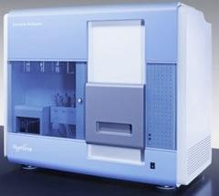
Paired-end sequencing: A molecular hack to sequence longer fragments
genomic DNA
Shear to desired length (~400bp)
DNA fragments
ligate adapters, size select
sequencing library
5’
5’
Illumina GA2
clusters on a flow-cell
millions to billions of paired-end reads (readpairs)
{
{
~100bp
{
~100bp
~200bp
5’ GGTGTACGAATAGTTTCCTTTTACACTCCTTGACCATCCTAGC --------------------------------//---------------------------------
Slide from Ira Hall
--------------------------------//--------------------------------- GGACTGAAACTTCATCTGTCTTTATAGATATGCGTGCAGCAGC 5’

Slide 17
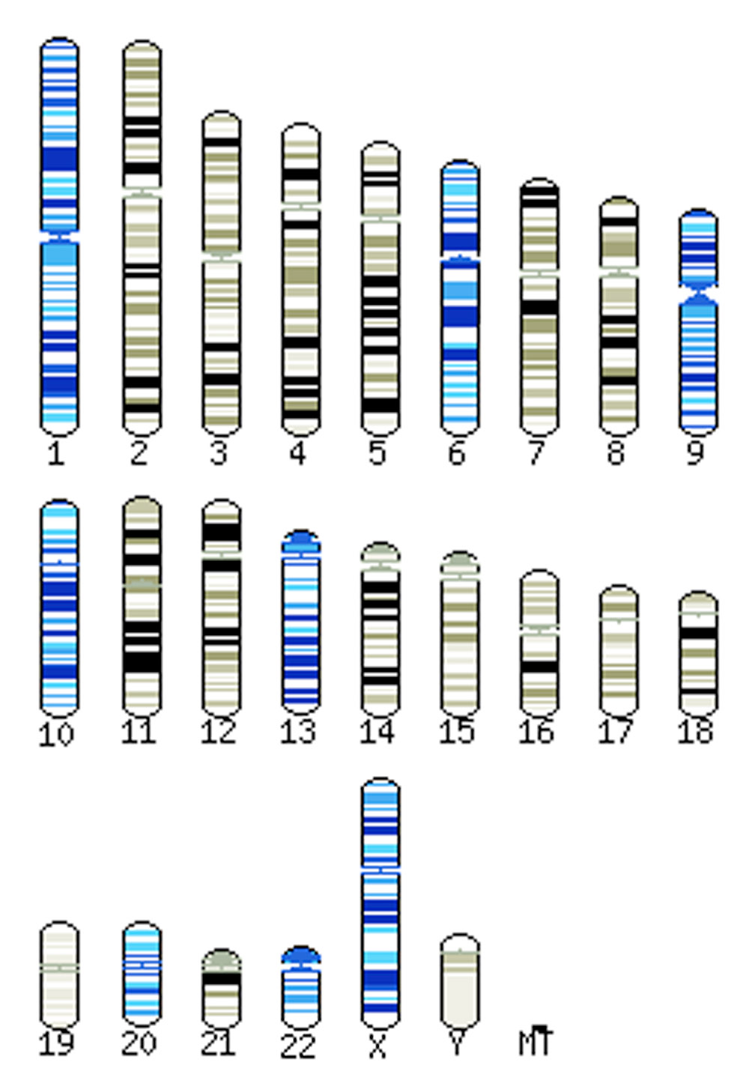

Aligning pairs of reads to the reference genome
1) a readpair
5’ GGTGTACGAATAGTTTCCTTTTACACTCCTTGACCATCCTAGC --------------------------------//---------------------------------
--------------------------------//--------------------------------- GGACTGAAACTTCATCTGTCTTTATAGATATGCGTGCAGCAGC 5’
2) a reference genome
on a computer
TATGGCAATTAAAATTGGTATCAATGGTTTTGGTCGTATCGGCCGTATCGTATTCCGTGCAGCACAACAC
CGTGATGACATTGAAGTTGTAGGTATTAACGACTTAATCGACGTTGAATACATGGCTTATATGTTGAAAT
ATGATTCAACTCACGGTCGTTTCGACGGCACTGTTGAAGTGAAAGATGGTAACTTAGTGGTTAATGGTAA
AACTATCCGTGTAACTGCAGAACGTGATCCAGCAAACTTAAACTGGGGTGCAATCGGTGTTGATATCGCT
GTTGAAGCGACTGGTTTATTCTTAACTGATGAAACTGCTCGTAAACATATCACTGCAGGCGCAAAAAAAG
TTGTATTAACTGGCCCATCTAAAGATGCAACCCCTATGTTCGTTCGTGGTGTAAACTTCAACGCATACGC
AGGTCAAGATATCGTTTCTAACGCATCTTGTACAACAAACTGTTTAGCTCCTTTAGCACGTGTTGTTCAT
GAAACTTTCGGTATCAAAGATGGTTTAATGACCACTGTTCACGCAACGACTGCAACTCAAAAAACTGTGG
ATGGTCCATCAGCTAAAGACTGGCGCGGCGGCCGCGGTGCATCACAAAACATCATTCCATCTTCAACAGG
TATGGCAATTAAAATTGGTATCAATGGTTTTGGTCGTATCGGCCGTATCGTATTCCGTGCAGCACAACAC
CGTGATGACATTGAAGTTGTAGGTATTAACGACTTAATCGACGTTGAATACATGGCTTATATGTTGAAAT
ATGATTCAACTCACGGTCGTTTCGACGGCACTGTTGAAGTGAAAGATGGTAACTTAGTGGTTAATGGTAA
AACTATCCGTGTAACTGCAGAACGTGATCCAGCAAACTTAAACTGGGGTGCAATCGGTGTTGATATCGCT
GTTGAAGCGACTGGTTTATTCTTAACTGATGAAACTGCTCGTAAACATATCACTGCAGGCGCAAAAAAAG
TTGTATTAACTGGCCCATCTAAAGATGCAACCCCTATGTTCGTTCGTGGTGTAAACTTCAACGCATACGC
AGGTCAAGATATCGTTTCTAACGCATCTTGTACAACAAACTGTTTAGCTCCTTTAGCACGTGTTGTTCAT
GAAACTTTCGGTATCAAAGATGGTTTAATGACCACTGTTCACGCAACGACTGCAACTCAAAAAACTGTGG
ATGGTCCATCAGCTAAAGACTGGCGCGGCGGCCGCGGTGCATCACAAAACATCATTCCATCTTCAACAGG
3) Alignment of the readpair to the reference genome gives coordinates describing where in the human genome the readpair came from
+ strand
- strand

Slide 18
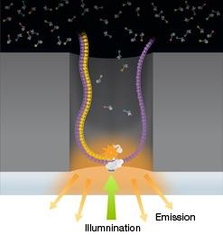
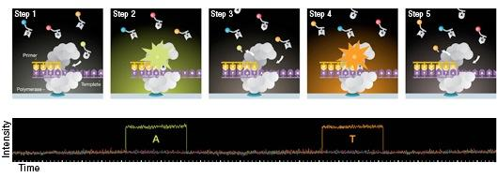
Pacific Biosciences
Key Points:
- 1 DNA molecule and 1 polymerase in each well
(zero-mode waveguide)
- 4 colors flash in real time as polymerase acts
- Methylated cytosine has distinct pattern
- No _theoretical_ limit to DNA fragment length
Caveats:
- higher error rate (1-2%)
- lower throughput : roughly 5 gigabases per run
Slide from Ira Hall

Slide 19
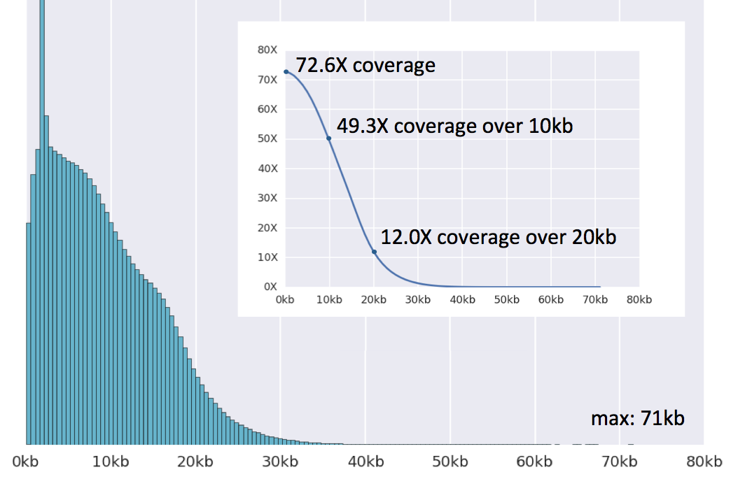
Pacific Biosciences: long reads. Great for genome assembly
http://schatzlab.cshl.edu/data/skbr3/

Slide 20
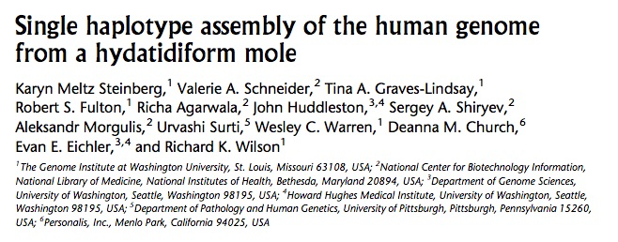
Pacific Biosciences: long reads. Great for genome assembly
Sequence and assemble a bacterial genome in 24 hours for ~ $500
Human genome for ~$10,000

Slide 21
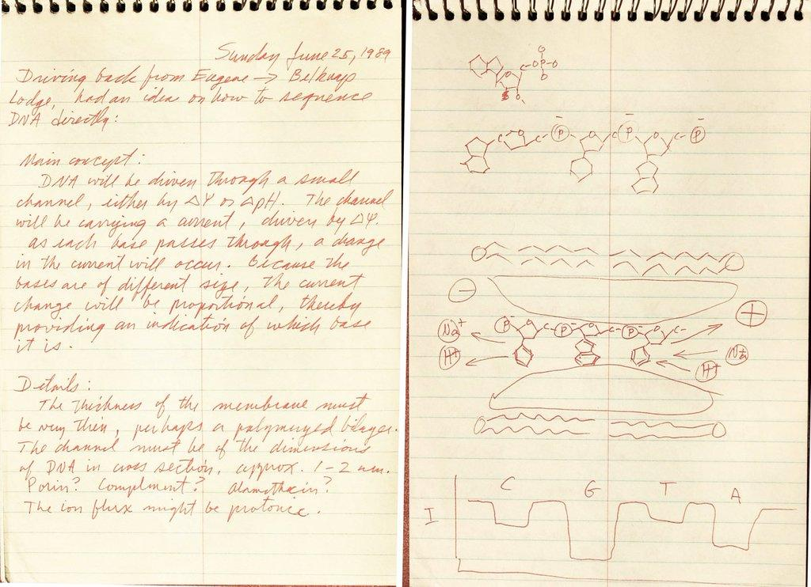
Nanopore sequencing is nearly three decades in the making
Notebook of David Deamer - June 25, 1989

Slide 22
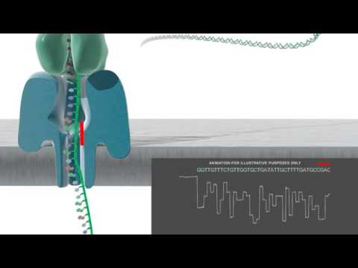
Oxford Nanopore Technologies

Slide 23
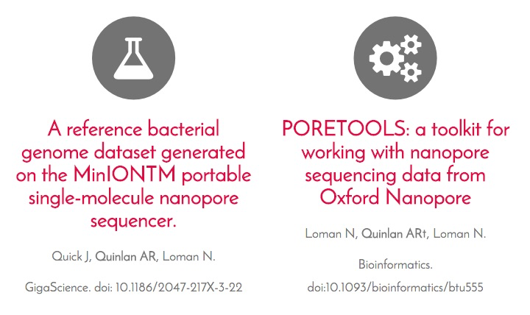
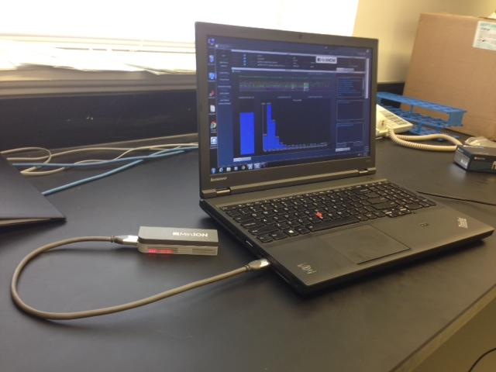
It works, which is rather magical!

Slide 24
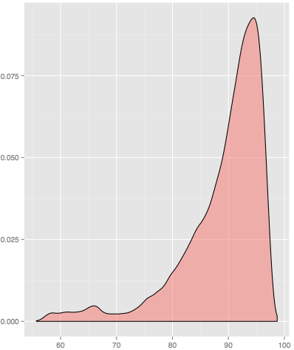
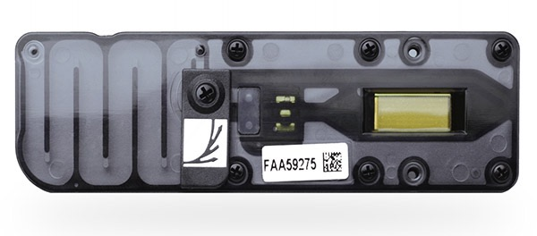
Nanopore sequencing with ONT is accurate and reliable
0.1
load libraries onto
array of 2,048 nanopores
0.075
92-93% identity
0.05
Density
0.025
0
2015 yield (R9 chemistry): ~500 Mbp
mean read size: 4-6 kbp
60
70
80
90
100
Read Percent Identity
Current yield per run ("R9.4" chemistry):
~5 Gbp, 97% identity (i.e., 3% error rate)
Notes:
pore is a CsG nanopore, adapted from bacterial amyloid secretes (1200 mutants tested)
processive Phi29 phage polymerase enzyme for “ratcheting” DNA thru pore

Slide 25
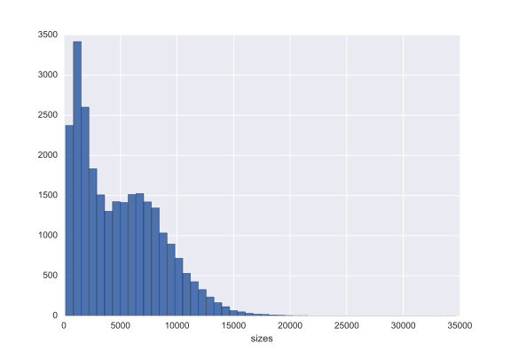
ONT sequence length distribution
Notes:
pore is a CsG nanopore, adapted from bacterial amyloid secretes (1200 mutants tested)
processive Phi29 phage polymerase enzyme for “ratcheting” DNA thru pore

Slide 26
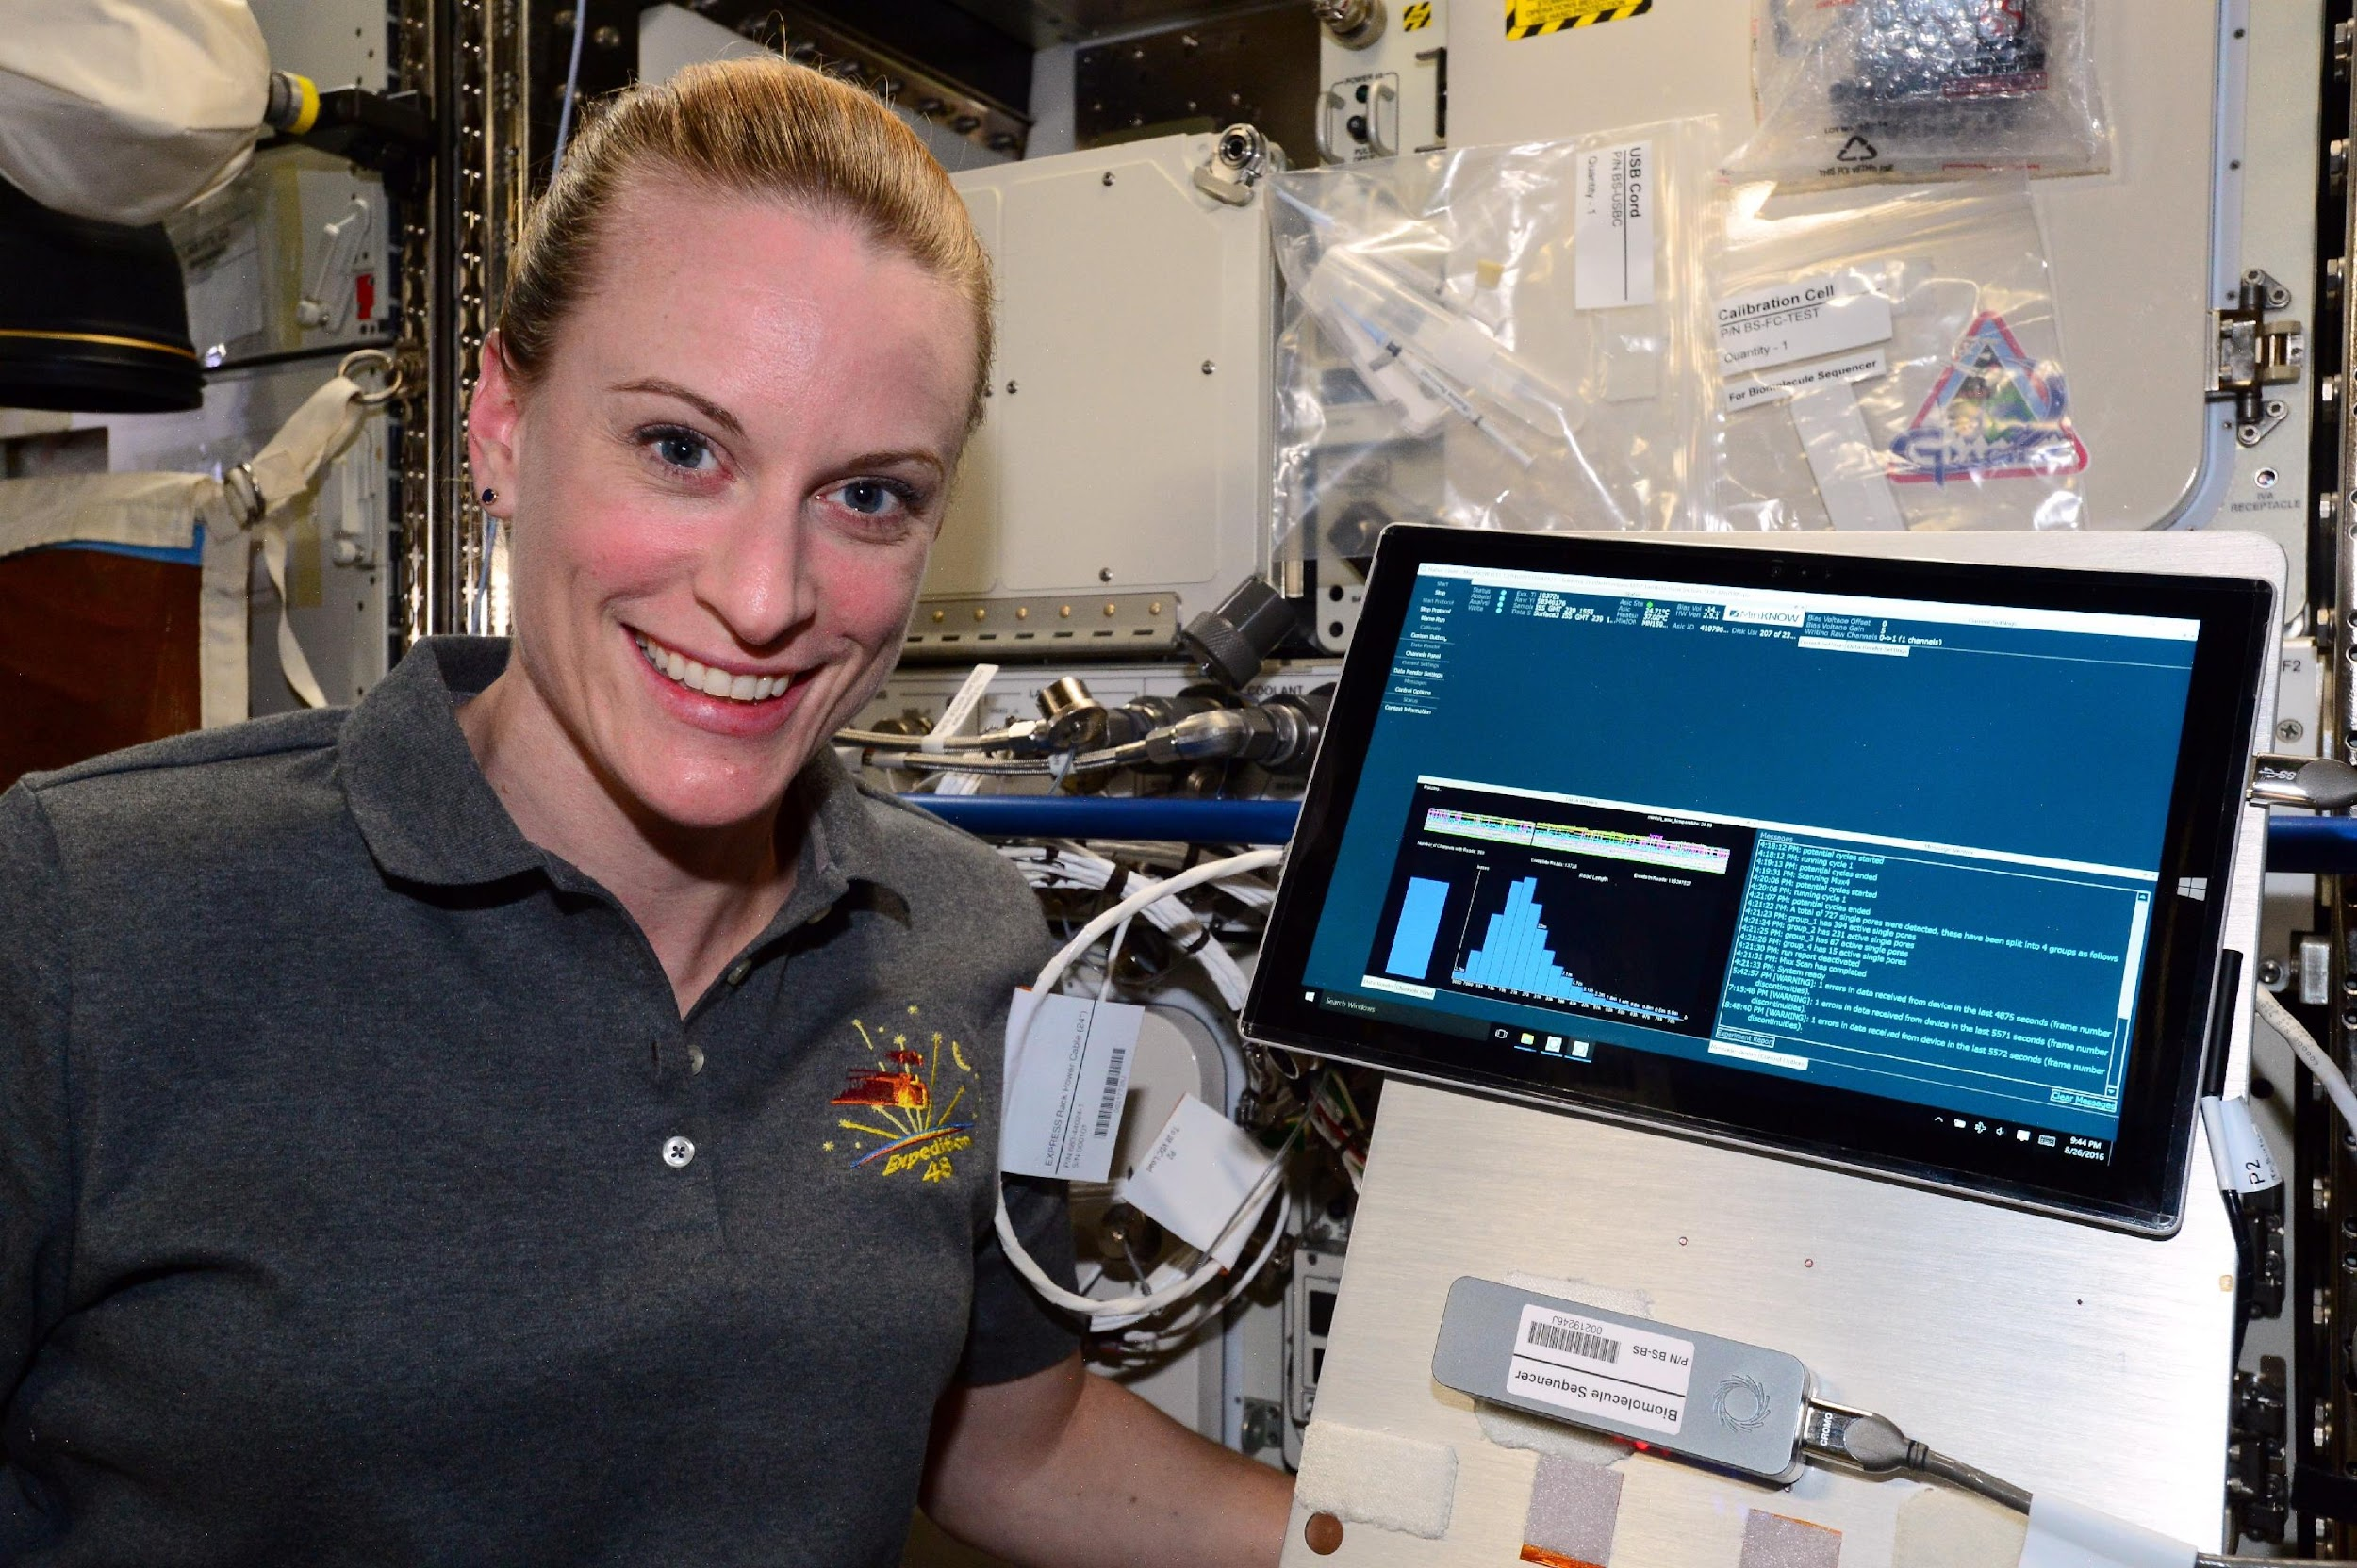
Nanopore sequencing is extremely portable
Kate Rubins sequencing DNA on the ISS
Notes:
so, we have a reliable, accurate, and portable tool with which we can ask cool biological questions…

Slide 27

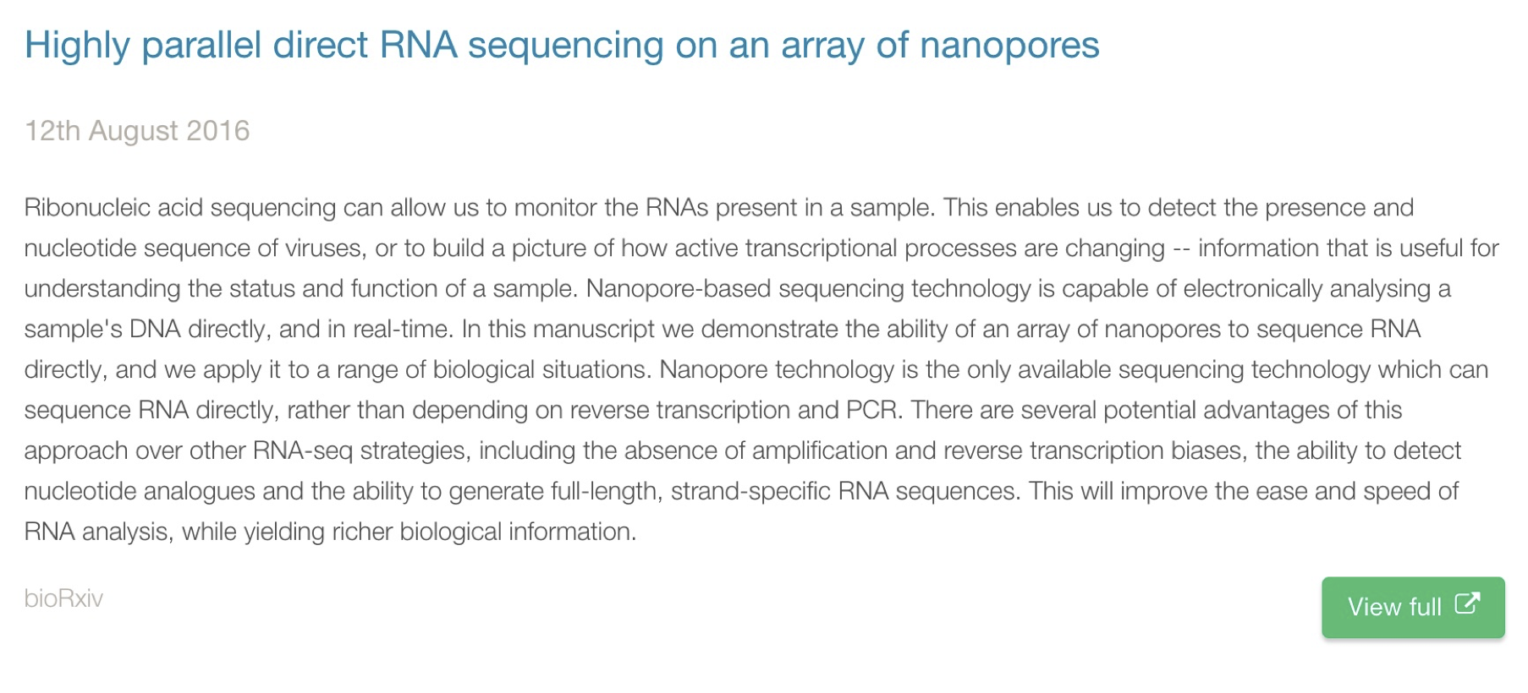
Notes:
pore is a CsG nanopore, adapted from bacterial amyloid secretes (1200 mutants tested)
processive Phi29 phage polymerase enzyme for “ratcheting” DNA thru pore

Slide 28
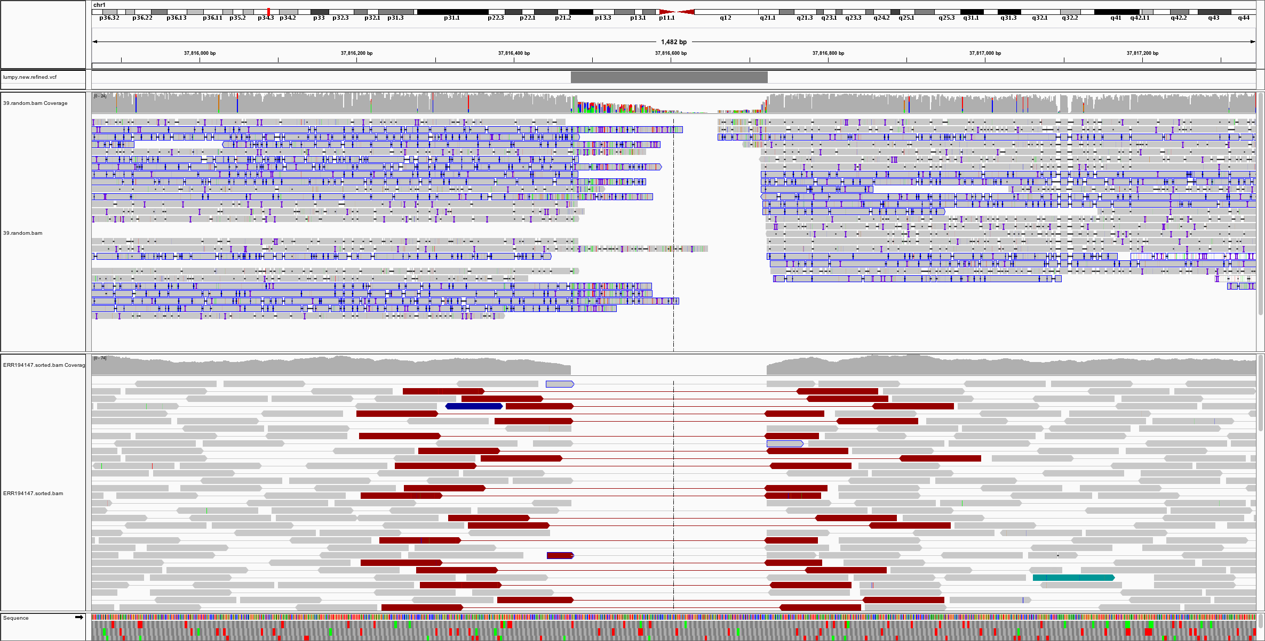
Homozygous deletion in NA12878: Illumina vs. ONT
ONT
Illumina
Notes:
pore is a CsG nanopore, adapted from bacterial amyloid secretes (1200 mutants tested)
processive Phi29 phage polymerase enzyme for “ratcheting” DNA thru pore

Slide 29
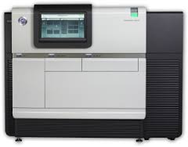
Base calling: the conversion of signal to a nucleotide sequence
Raw signal
(e.g., 454 Life Sciences)
Errors happen.
Hopefully infrequently
Base calling algorithms
ACCTTCGAACGGCGGGGGGTTACAA
Notes:
processive Phi29 phage polymerase enzyme for “ratcheting” DNA thru pore

Slide 30
(Mostly) all technologies yield DNA sequences in FASTQ format
DNA
@seq1
ACCTTCGAACGGCGGGGGGTTACAA
+
!''*((((***+))%%%++).1***
@seq2
TGGAACCGAACGGCCCCGGTTACAT
+
!''*!!!!***+))+++++).1***
And so on...
Notes:
processive Phi29 phage polymerase enzyme for “ratcheting” DNA thru pore

Slide 31
The FASTQ format. Welcome to a minor hell.
A “standard” format for storing and defining sequences
from next-generation sequencing technologies.
Sequence ID
Sequence
<separator>
Quality scores
@SEQ_ID
GATTTGGGGTTCAAAGCAGTATCGATCAAATAGTAAATCCATTTGTTCAACTCACAGTTT
+
!''*((((***+))%%%++)(%%%%).1***-+*''))**55CCF>>>>>>CCCCCCC65
http://en.wikipedia.org/wiki/FASTQ_format
Notes:
pore is a CsG nanopore, adapted from bacterial amyloid secretes (1200 mutants tested)
processive Phi29 phage polymerase enzyme for “ratcheting” DNA thru pore

Slide 32
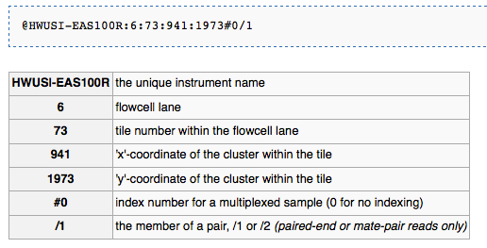
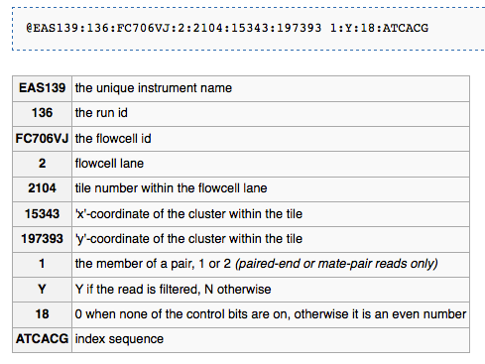
The FASTQ format's sequence identifier (first line of each record)
Old format
New format
Notes:
pore is a CsG nanopore, adapted from bacterial amyloid secretes (1200 mutants tested)
processive Phi29 phage polymerase enzyme for “ratcheting” DNA thru pore

Slide 33
FASTQ quality scores: estimate of confidence in each base
(sequencing technologies make errors!)
Sequence ID
Sequence
<separator>
Quality scores
@SEQ_ID
GATTTGGGGTTCAAAGCAGTATCGATCAAATAGTAAATCCATTTGTTCAACTCACAGTTT
+
!''*((((***+))%%%++)(%%%%).1***-+*''))**55CCF>>>>>>CCCCCCC65
Qualities are based on the Phred scale and are encoded
Q = -10*log10(Perr)
Note:
The Ph in Phred comes from Phil Green, the inventor of the encoding
http://www.gs.washington.edu/faculty/green.htm
Notes:
pore is a CsG nanopore, adapted from bacterial amyloid secretes (1200 mutants tested)
processive Phi29 phage polymerase enzyme for “ratcheting” DNA thru pore

Slide 34
Phred quality score calculation
Q = -10*log10(Perr)
Error probability
(P_{err})
Phred quality score
log₁₀(P_{err})
1
0
0
0.1
-1
10
0.01
-2
20
0.001
-3
30
0.0001
-4
40
Notes:
pore is a CsG nanopore, adapted from bacterial amyloid secretes (1200 mutants tested)
processive Phi29 phage polymerase enzyme for “ratcheting” DNA thru pore

Slide 35
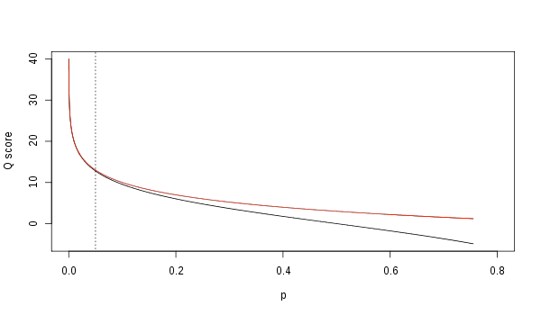
A higher quality score is better (>=20 is considered "good")
Quality score
Prob(error)
Notes:
pore is a CsG nanopore, adapted from bacterial amyloid secretes (1200 mutants tested)
processive Phi29 phage polymerase enzyme for “ratcheting” DNA thru pore

Slide 36
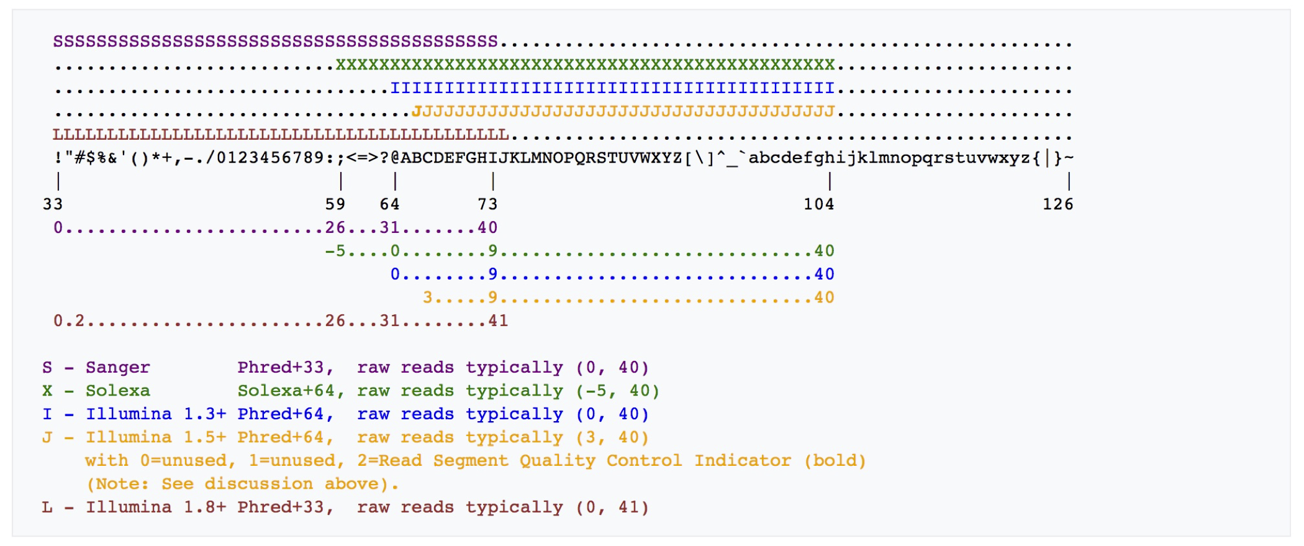
Historically, FASTQ has had different encoding schemes for encoding PHRED quality scores. Ouch.
Current encoding:
! = quality 0
J = quality 41
Notes:
pore is a CsG nanopore, adapted from bacterial amyloid secretes (1200 mutants tested)
processive Phi29 phage polymerase enzyme for “ratcheting” DNA thru pore

Slide 37
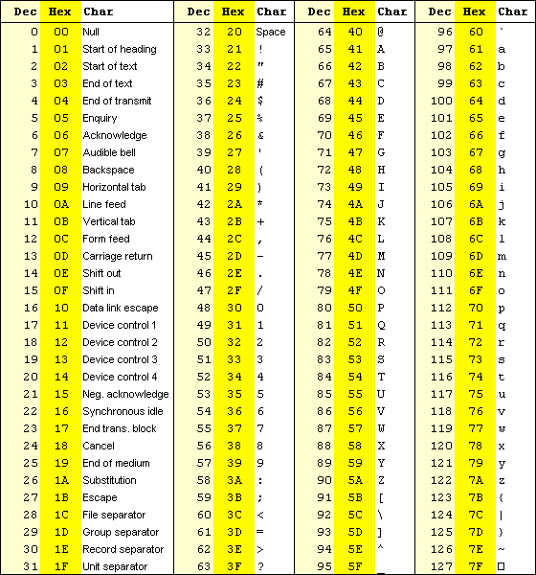
Quality score encoding based on ASCII table. Geekery.
Formula for getting PHRED quality
from encoded quality:
Q = ascii(char) - 33
Example:
!+EJ
ASCII
33
43
69
74
-33
0
10
36
41
Notes:
pore is a CsG nanopore, adapted from bacterial amyloid secretes (1200 mutants tested)
processive Phi29 phage polymerase enzyme for “ratcheting” DNA thru pore

Slide 38
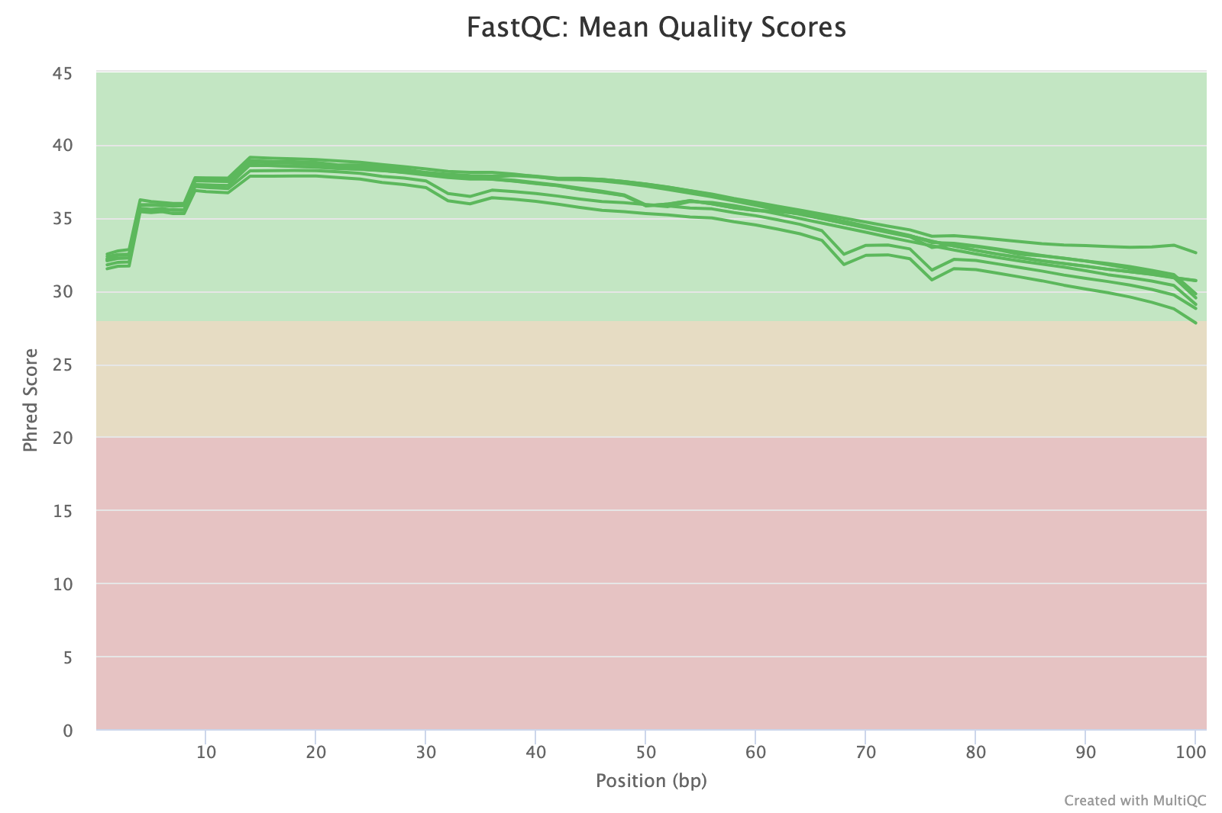
FASTQC: Is my sequence data any good?
http://www.bioinformatics.babraham.ac.uk/projects/fastqc/
Notes:
pore is a CsG nanopore, adapted from bacterial amyloid secretes (1200 mutants tested)
processive Phi29 phage polymerase enzyme for “ratcheting” DNA thru pore

Slide 39

MultiQC: https://multiqc.info/
Notes:
processive Phi29 phage polymerase enzyme for “ratcheting” DNA thru pore

Slide 40
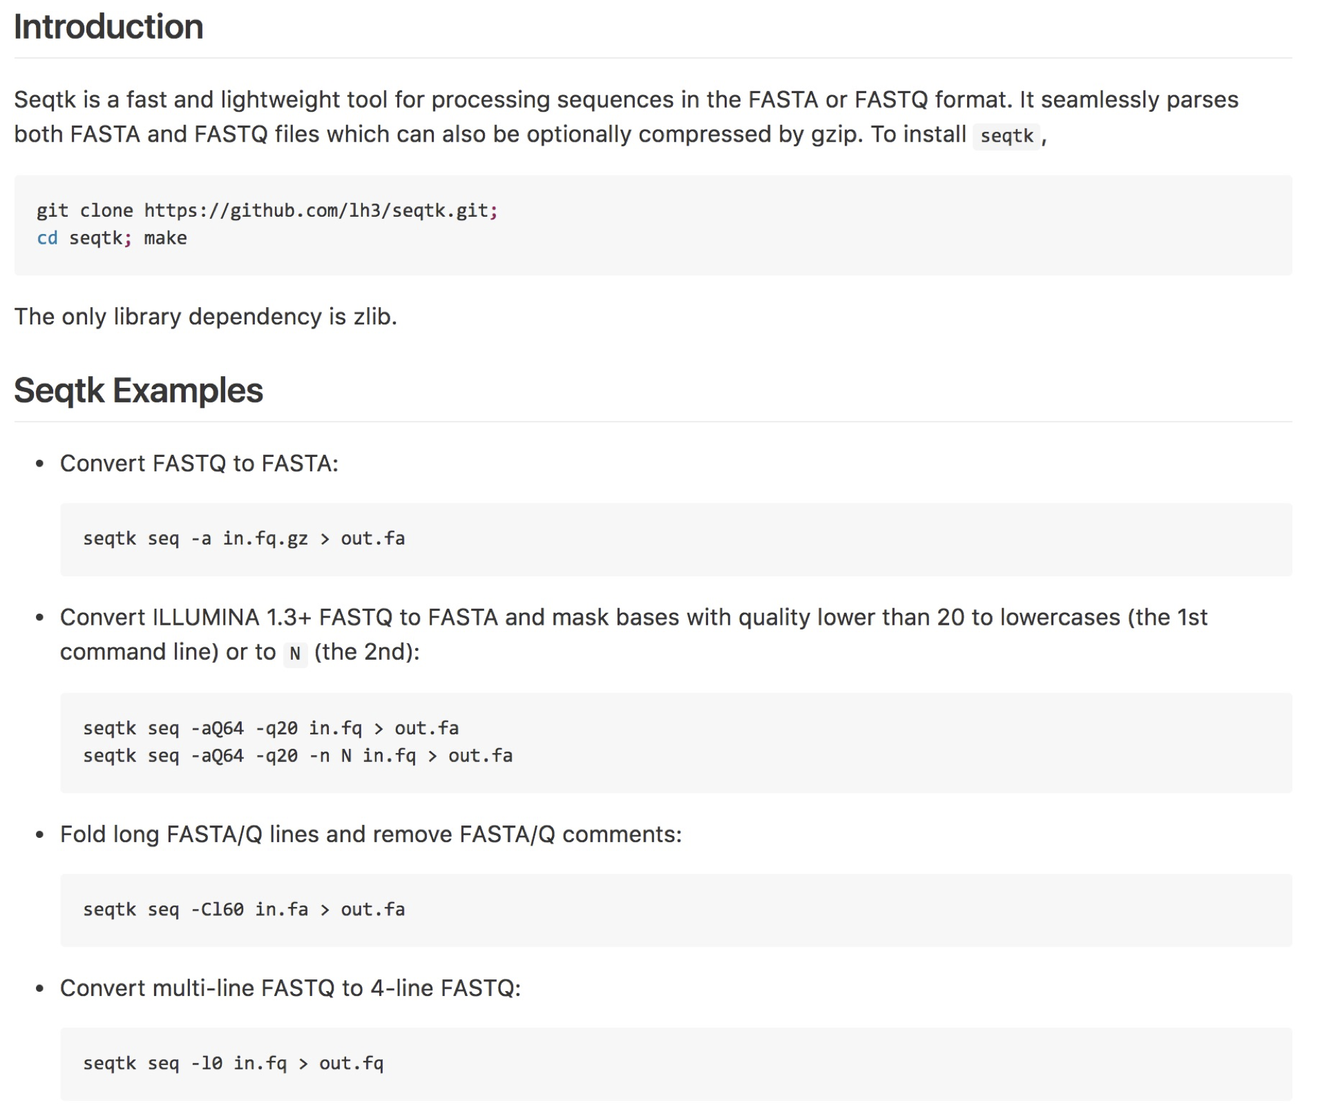
seqtk: manipulating FASTQ and FASTA files
https://github.com/lh3/seqtk
Notes:
processive Phi29 phage polymerase enzyme for “ratcheting” DNA thru pore

Slide 41
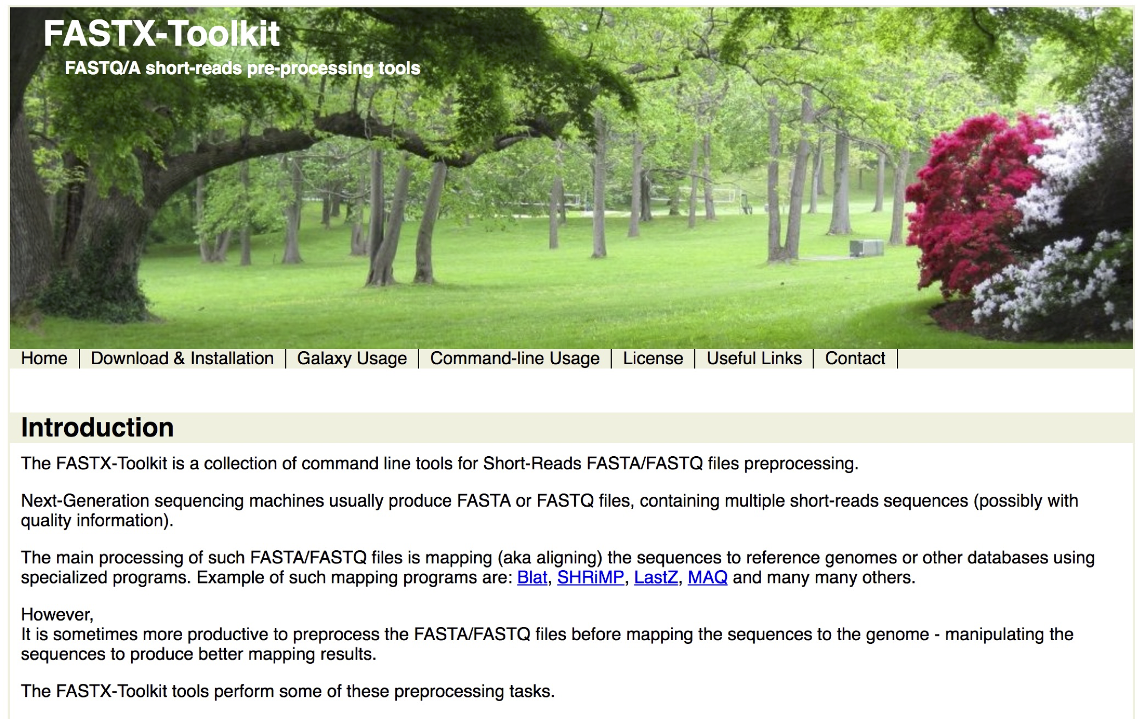
fastx toolkit: manipulating FASTQ and FASTA files
http://hannonlab.cshl.edu/fastx_toolkit/
Notes:
pore is a CsG nanopore, adapted from bacterial amyloid secretes (1200 mutants tested)
processive Phi29 phage polymerase enzyme for “ratcheting” DNA thru pore

Slide 42
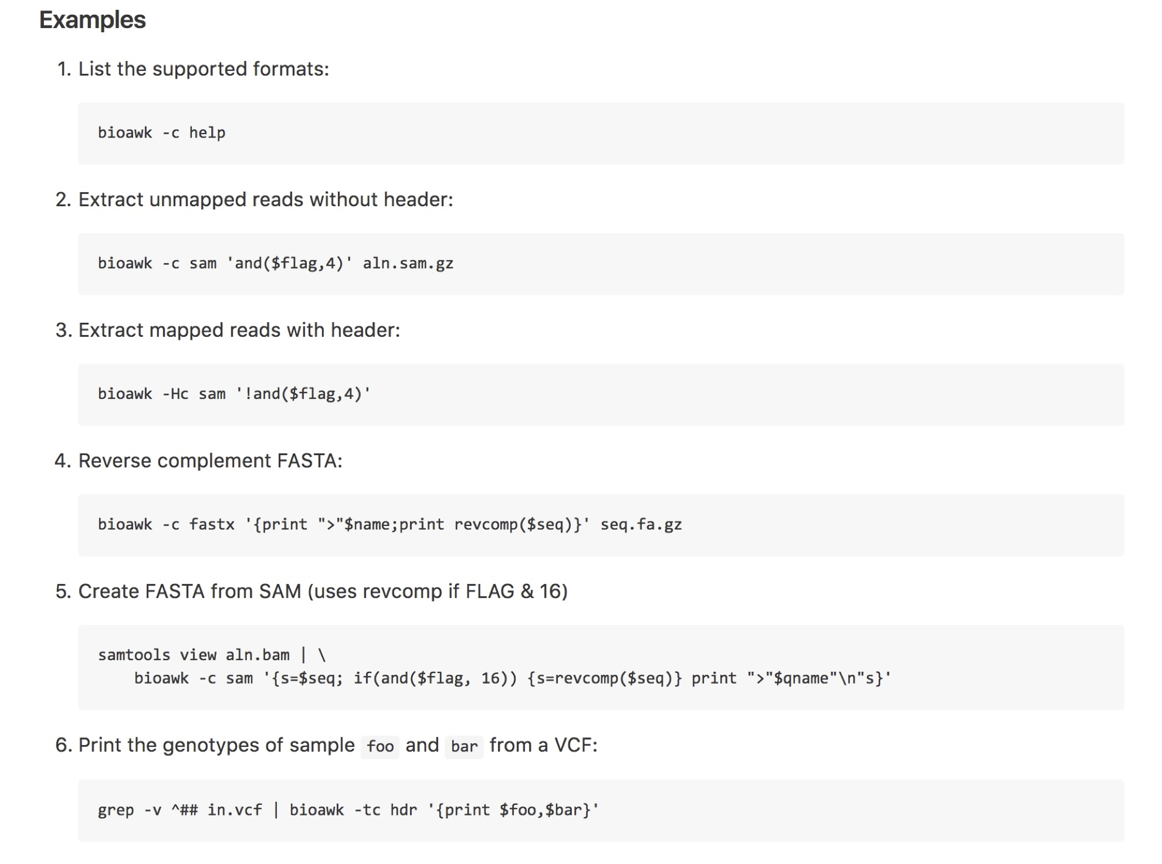
bioawk: awk that is enhanced for genomics formats.
Print tab separated sequence ID and sequence from a FASTQ file
$ bioawk -c fastx '{print $name"\t"$seq}' test.fastq
SRR3750603.1 NTCGGAACATTTTTTCTTCAAAAATATGAAAAATCACCTAATTTATCTGAAAATGACATTTANNNCAGTNNNNNNNATTGGGAAAGTGCTCGATTTNCGGA
SRR3750603.2 TGTAATTTACTTTGTTCAGTTAGACTCTTAATTAGACTAAAAACGGTCTCAAAAAGTATAATTTCATAATGAGACACCTTTAAAAATTCTACGTTTTTATG
SRR3750603.3 AGTTTTCTCAAACACAGAAAACATATGGGAGTTTCTCAAACAATGGACAATGAGTGATCACCGATATTTGATACAAATCGACCAACTCGGCTCATATTCTC
https://github.com/lh3/bioawk
Notes:
pore is a CsG nanopore, adapted from bacterial amyloid secretes (1200 mutants tested)
processive Phi29 phage polymerase enzyme for “ratcheting” DNA thru pore

